Slide 1
ESHERS
CLIMATE ACTION WEBSITE
By Dinesh & Ramesh

Slide 2
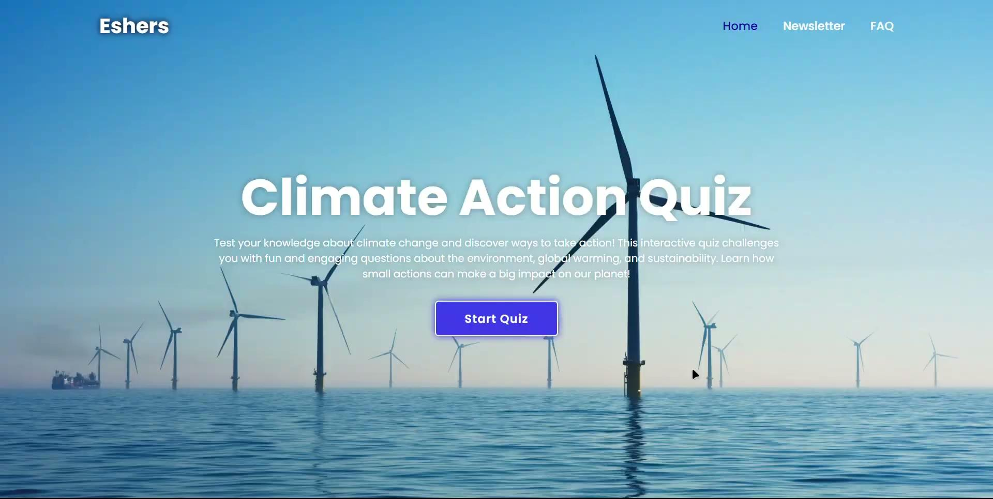
01
Home Page
The Homepage features :
- Logo prominently displayed
- Navigation header with links to:
- Home
- Newsletter
- FAQ
- Brief description of the Climate Action Quiz
- "Start Quiz" button for easy access

Slide 3

02
Quiz Guide Pop Up
Quiz Guide
- 1. Focus on Key Concepts
- 2. Practice with Sample Questions
- 3. Review Class Notes
- 4. Test Your Recall
- 5. Stay Calm and Confident
Buttons:
- Exit Quiz
- Continue

Slide 4
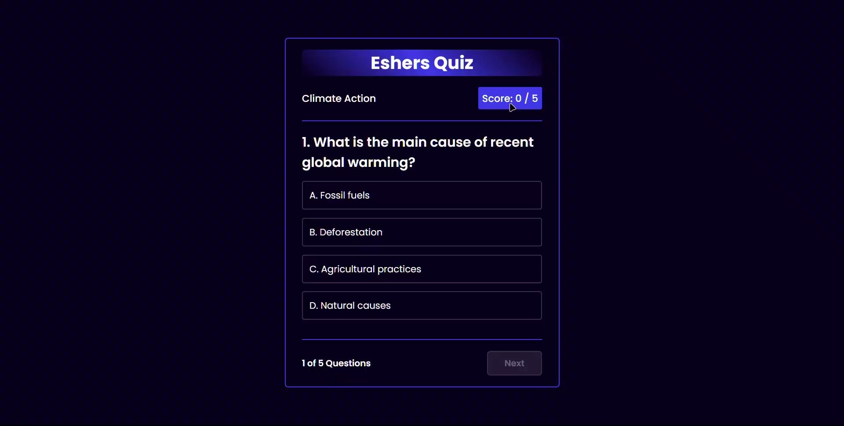
03
Quiz
- Quiz Title: Eshers Quiz
- Category: Climate Action
- Current Score: 0 / 5
- Question: (To be displayed)
- Options: (To be displayed)
Quiz Progress:
- Question 1 of 5
Navigation:
- Next Button

Slide 5

04
FAQ (Gemini AI)
Header:
- Title: "Hello, there"
- Subtitle: "How can I help you today?"
Suggested Queries:
- Tracking climate change data using NASA resources.
- Effective ways to reduce carbon footprint.
- Finding the latest news on climate action initiatives.
- Understanding global warming trends with NASA's climate data.
Chat Interface:
- Area for chat messages.
- Input form with a prompt field and a send button.
- Action buttons for theme toggle and deleting chat history.
Disclaimer:
- Note about potential inaccuracies in Gemini’s responses.

Slide 6
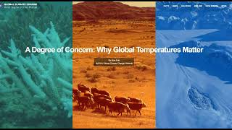
05
Climate News App: NASA RSS Feed Integration
Real-time climate news from NASA
Fetches and displays up to 5 latest climate news items
Each news item includes:
Title, publication date, description preview
"Read More" link to full article

Slide 7
06
Visualize global temperature and CO2 level trends
Clear visualization of climate trends
Displays data from 1880 to 2024
Dual Y-axis for temperature (°C) and CO2 levels (ppm)
Data Sources
NASA and NOAA climate data
Links provided for temperature and CO2 concentration data

Slide 8
07
Interactive short courses on climate-related topics
6 courses covering various climate topics
Bite-sized, accessible climate education
Interactive and visually engaging content
Variety of topics for different interests and skill levels
Easy navigation and progress tracking

Slide 9
THANK YOU

